Slide 1
Adding Conditional Control to Text-to-Image Diffusion Models
Lvmin Zhang, Anyi Rao, Maneesh Agrawala, “Adding Conditional Control to Text-to-Image Diffusion Models”, in Proc. the IEEE/CVF Conference on Computer Vision and Pattern Recognition (CVPR), 2024. Available: https://arxiv.org/abs/2302.05543
2025-03-25
Sein Choi
Intelligent Vision Processing Lab. (IVPL)
https://ivpl.sookmyung.ac.kr
Div. of AI Engineering, Sookmyung Women’s University
E-mail: csi1806@sookmyung.ac.kr

Slide 2
No. | Title | Keyword | Cite
1 | Learning Transferable Visual Models From Natural Language Supervision | Contrastive Learning, Multimodal Representation | Alec Radford, Jong Wook Kim. (2021). Learning Transferable Visual Models From Natural Language Supervision, In Proc. of the 38th International Conference on Machine Learning, pages 8748–8763. PMLR. [Online]. Available: https://arxiv.org/abs/2103.00020
2 | GLIDE: Towards photorealistic image generation and editing with text-guided diffusion models | Text-to-Image Generation, Diffusion Models, guided image synthesis | A Nichol, P. Dhariwal, A. Ramesh. “GLIDE: Towards photorealistic image generation and editing with text-guided diffusion models”, In Proc. of the 39th International Conference on Machine Learning, 2022, pp. 16907-16921. Available: https://arxiv.org/abs/2112.10741
3 | Hierarchical Text-Conditional Image Generation with CLIP Latents | Text-to-Image Generation, CLIP Latents, unCLIP, Diffusion Models | Ramesh A, Dhariwal P, Nichol A, Chu C, Chen M., “Hierarchical Text-Conditional Image Generation with CLIP Latents”, 2022, Available: https://arxiv.org/abs/2112.10741
4 | High-Resolution Image Synthesis with Latent Diffusion Models | Text-to-Image Generation, VAE, Diffusion Models, Cross-Attention | Rombach, R., Blattmann, A., Lorenz, D., Esser, P., & Ommer, B.,"High-Resolution Image Synthesis with Latent Diffusion Models," in Proc. the IEEE/CVF Conference on Computer Vision and Pattern Recognition (CVPR), 2022. Available: https://arxiv.org/abs/2112.10752
5 | SDXL: Improving Latent Diffusion Models for High-Resolution Image Synthesis | LDM | D. Podell, Z. English, K. Lacey, A. Blattmann, T. Dockhorn, J. Müller, J. Penna, and R. Rombach, "SDXL: Improving Latent Diffusion Models for High-Resolution Image Synthesis,“, in Proc. the IEEE/CVF Conference on Computer Vision and Pattern Recognition (CVPR), 2023. Available: https://arxiv.org/abs/2307.01952.
6 | Adding Conditional Control to Text-to-Image Diffusion Models | Stable Diffusion, zero convolution, trainable copy | Lvmin Zhang, Anyi Rao, Maneesh Agrawala, “Adding Conditional Control to Text-to-Image Diffusion Models”, in Proc. the IEEE/CVF Conference on Computer Vision and Pattern Recognition (CVPR), 2024. Available: https://arxiv.org/abs/2302.05543

Slide 3
Contents
Introduction
ControlNet
Ablation Study
Training
Evaluation & Conclusion

Slide 4
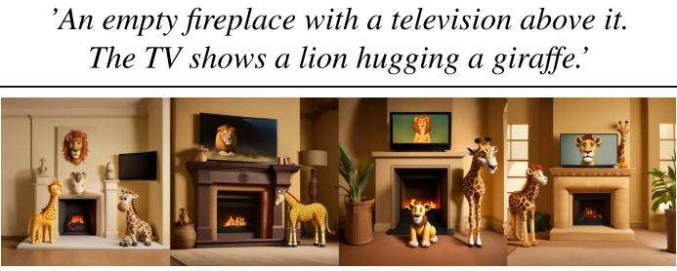
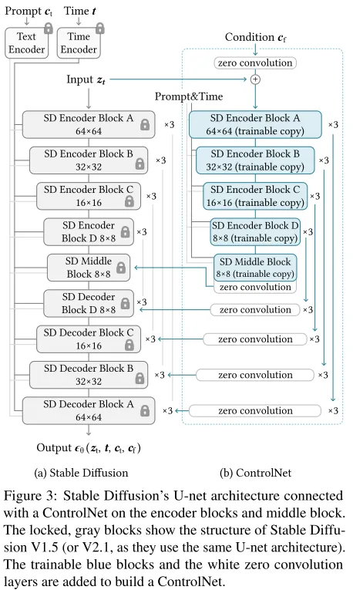
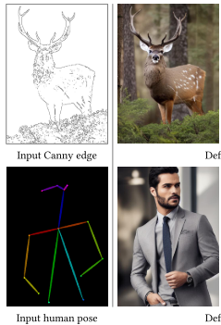
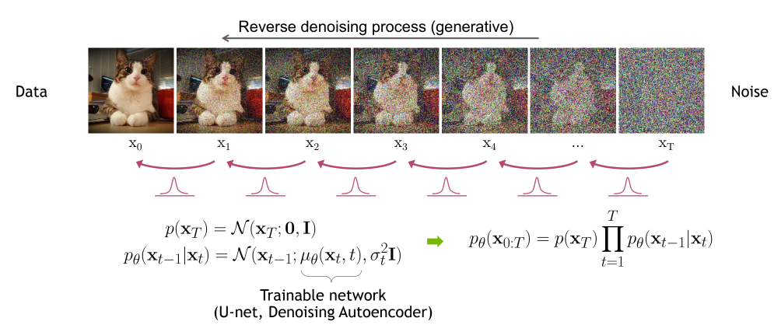
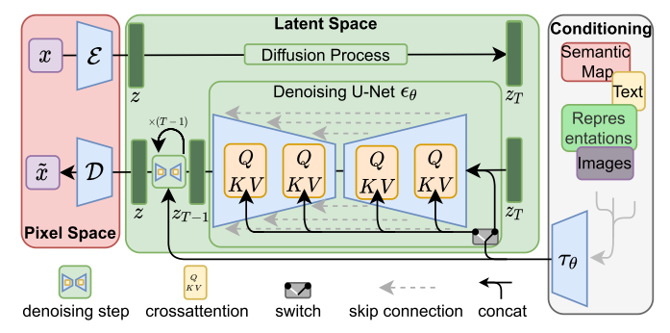
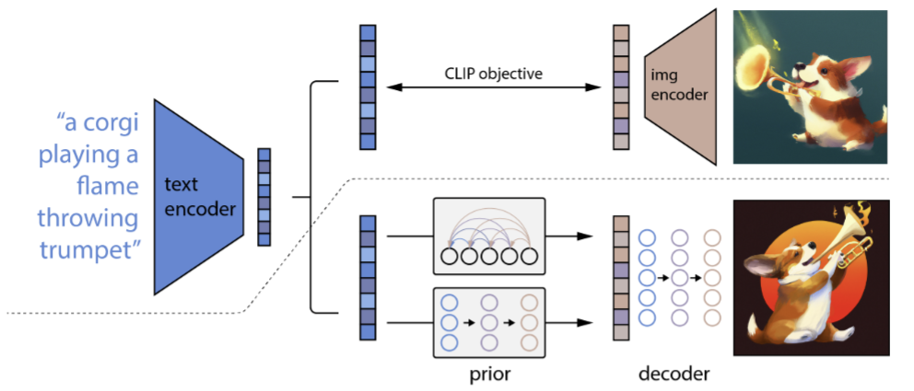
Introduction
The limitations of T2I models: Limited control over the spatial composition of images
Need for finer-grained spatial control, So adding a conditioning image
Model learns how to match the conditioning to target image
Finetuning Large pretrained moel cause overfitting or catastrophic forgetting
So propose ControlNet; end-to-end network that learns conditional control for large pretrained T2I diffusion models (such as Stable Diffusion)
SDXL Limitations
DDPM/DDIM
LDM (T2I w. extra Conditioning)
DALL-E2 (T2I)
ControlNet
Notes:
DALL-E2, LDM 둘 다 T2I 기반 모델로 학습은 이미지, 텍스트를 둘 다 넣어서 연관성을 학습하지만, 실제 inference 시에는 text prompt만 넣어서 이미지를 생성하는 T2I 모델이다.
T2I 모델들의 한계: 이미지의 spatial composition에 대한 control이 limited
finer grained spatial control 의 필요성, conditioning image를 추가로 주자
conditioning image를 target image로 매칭하는 방법을 학습
Large pretrained model때문에 fine-tuning하면 overfitting, catastrophic forgetting
따라서 large pretrained text-to-image diffusion model(Stable Diffusion) 에 대한 conditional control을 학습하는 end-to-end 신경망인 ControlNet을 고안

Slide 5
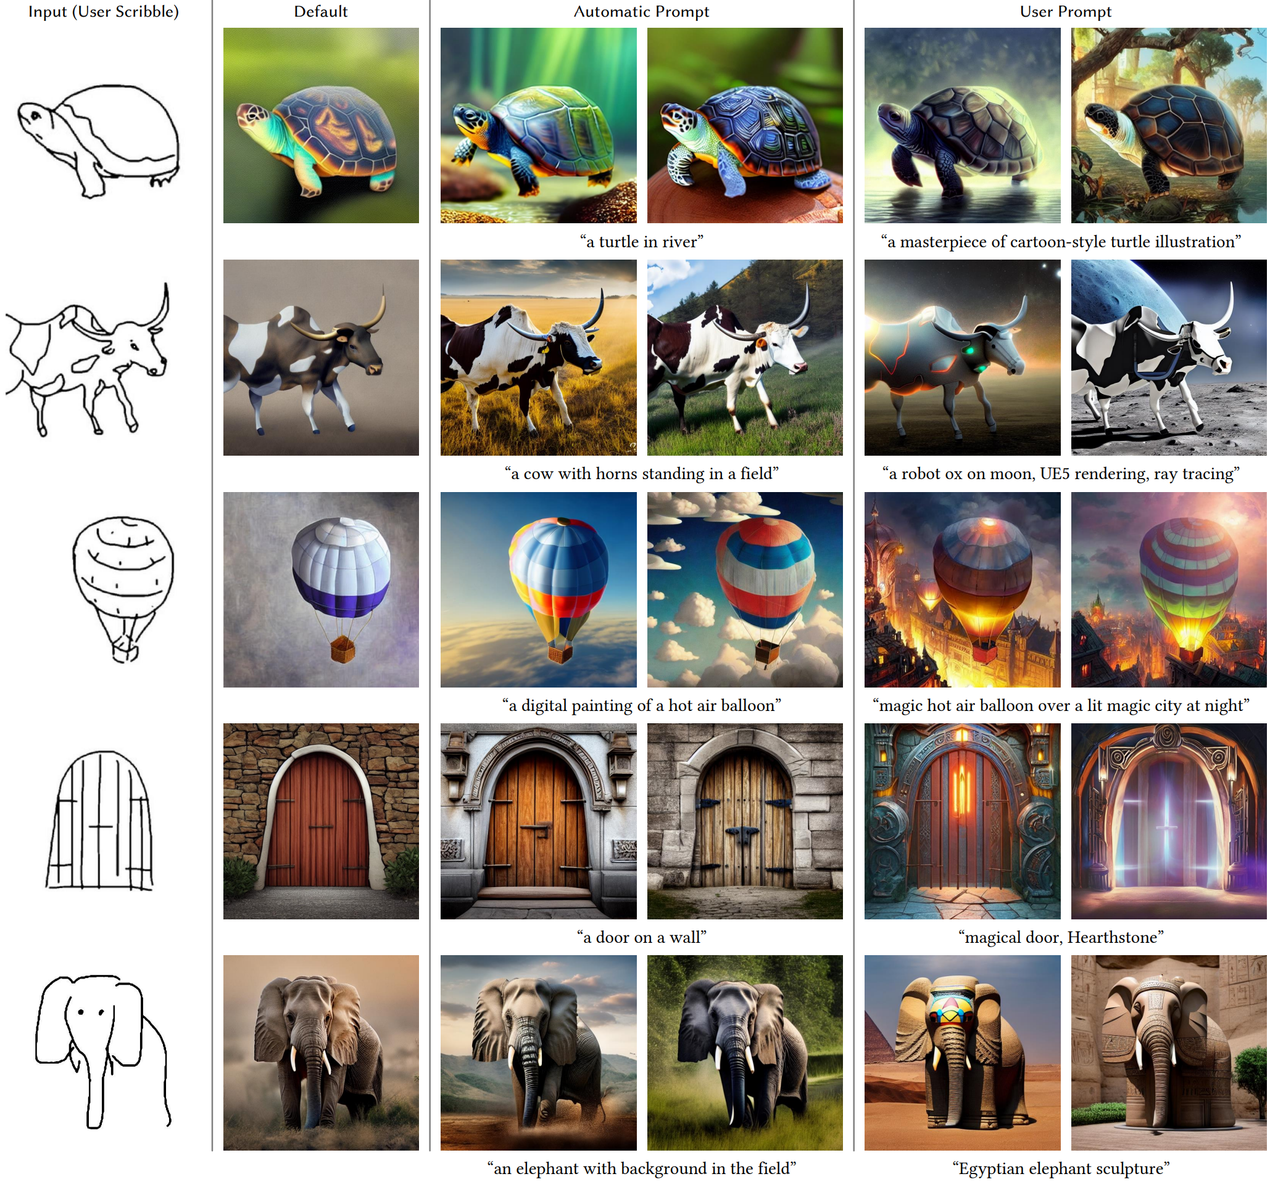
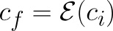
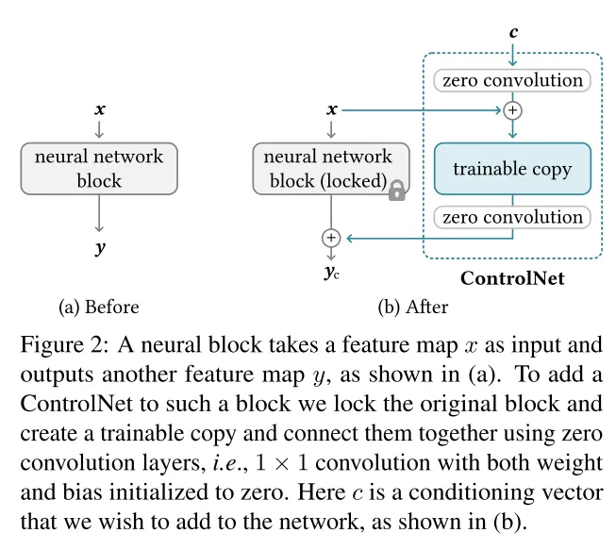
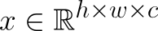
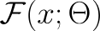
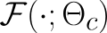
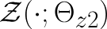
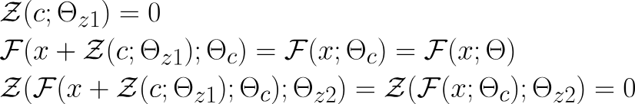
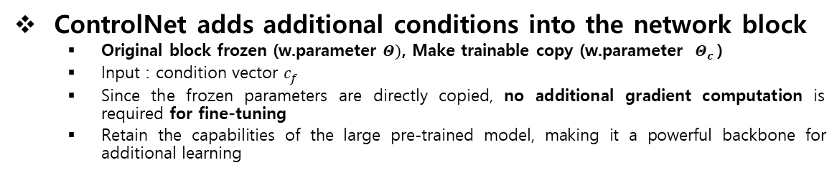
ControlNet
positional encoding
ControlNet adds additional conditions into the network block
Original block frozen (w.parameter $Θ)$, Make trainable copy (w.parameter $Θ_{c}$)
Input : condition vector $c_{f}$
Since the frozen parameters are directly copied, no additional gradient computation is required for fine-tuning
Retain the capabilities of the large pre-trained model, making it a powerful backbone for additional learning
OenAI CLIP
512x512
64x64 feature map
(4 ResNet + 2 ViTs)
2D Feature map
2D Feature map
zero-convolution
Trick to stabilize training w. trainable copy
Zero-convolution protect harm random noise during the initial training phase, protecting this backbone.
1x1 Contolution Layer
weight : 0
bias : 0
Q. Why they didn’t add trainable copy in Decoder?
Notes:
ControlNet은 신경망 block에 추가 condition을 주입
original block을 파라미터 $Θ$로 freeze, 파라미터 $Θ_{c}$인 trainable copy로 블록 복제
condition c_f인 vector c를 input으로 받음, SD의 generative 능력 유지하면서 다양한 input 처리 가능
frozen된 파라미터 그대로 copy에 가져왔기 때문에, finetuning에 필요한 추가 gradient computation이 필요없다.
이렇게 Trainable Copy만 병렬로 연결해주면 문제가 있는데요. 학습 초창기 불안한 모습을 보인다. 아무래도 학습이 완료된 모델에, 병렬로 추가 파라미터를 붙여놓고 새로운 데이터로 학습을 해주면 Loss 그래프가 크게 흔들리겠죠. 이를 안정화해줄 트릭
zero-convolution
Zero convolution은 초기 학습 단계에서 harmful random noise를 제거하여 이 backbone 보호
Q. harmful noise란?
네트워크가 학습을 시작할 때 발생할 수 있는 불안정한 상태. (ex. random noise로 초기화할 때 초기 학습이 불안정)
Q. decoder에 trainable copy 안 붙이는 이유?
인코더 수준의 control만으로도 효과를 얻음,(파라미터를 감소해야 좋기 때문에 덜어냄)
또한 Decoder는 추출된 feature를 사용해서 이미지를 생성하는 역할인데, 이는 기존의 SD에서 잘 학습되었기 때문에 이미지 생성에 문제 없음
인코더 단에서 task-specific하게 특징만 잘 뽑아주면 됨

Slide 6
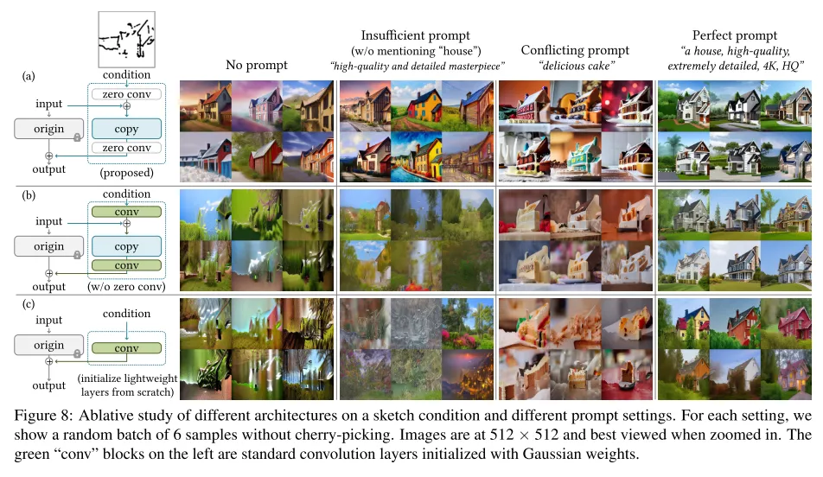
Ablation Study
ControlNet works effectively in all prompt settings
Demonstrating the structural effectiveness of zero convolution
ControlNet
zero conv
-> gaussian conv
ContolNet-lite

Slide 7
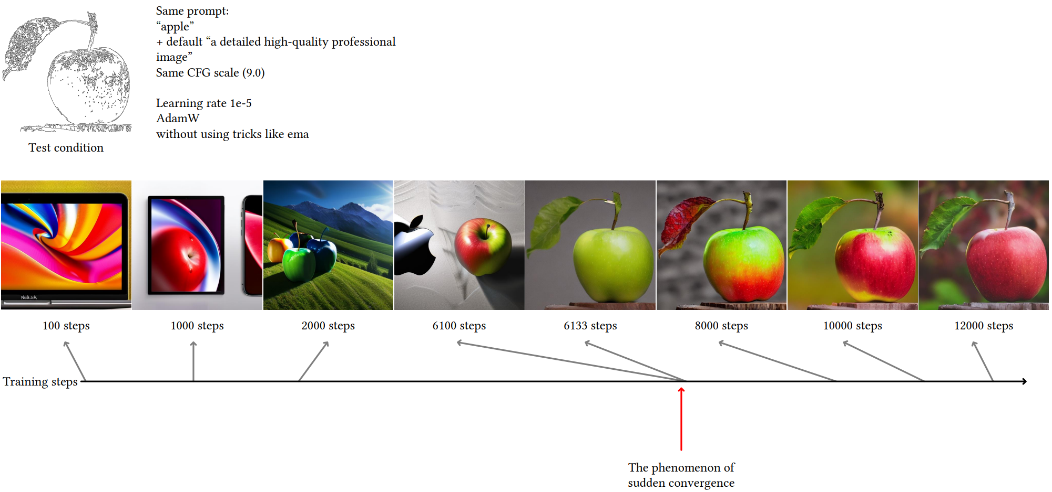
Training
Loss Function (Learning objective)
50% Empty string of Text Prompt
Increased Model's Semantic Recognition Ability
Sudden convergence phenomenon
Training Resource
20,000 training samples, single Nvidia RTX 3090Ti for 5 Days
Notes:
z_0 : input image
z_t : 노이즈 추가된 이미지
t : time step; 노이즈 추가 횟수
c_t : text propmpt
c_f : task-specific condition
image diffusion algorithm은 network epsilon_theta를 학습, 노이즈 이미지 z_t에 대하여 추가된 노이즈를 예측
학습 중에 50%의 텍스트 프롬프트 ct를 빈 문자열로 랜덤하게 바꾼다. 이는 입력 조건 map에서 의미론적 내용을 인식하는 ControlNet의 능력을 용이하게 한다. 이것은 주로 Stable Diffusion 모델에 대한 프롬프트가 표시되지 않을 때 인코더가 프롬프트 대신 입력 제어 map에서 더 많은 semantic을 학습하는 경향이 있기 때문이다

Slide 8
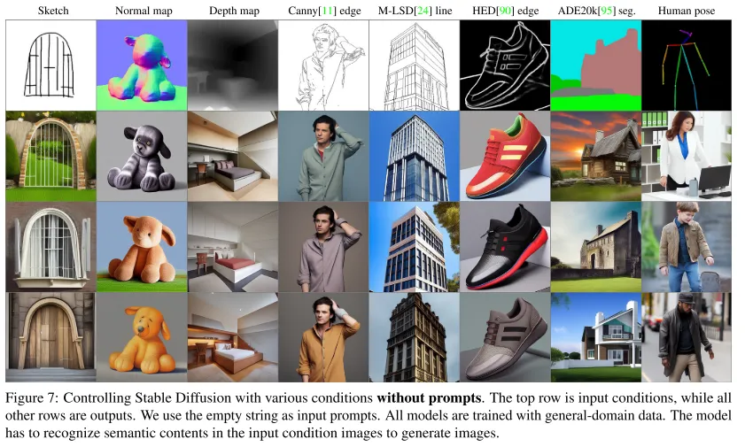
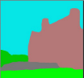
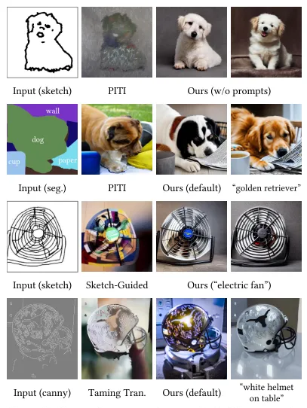
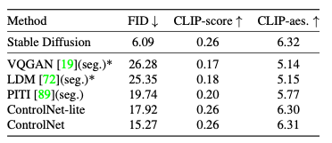
Evaluation & Conclusion
backbone
: GLIDE
Pros
Adds spatial conditioning(image) for fine-grained image generation
Utilizes existing models, reducing computation;
requires 23% more GPU memory and 34% additional training time compared to SD optimization
Supports various conditioning formats
Cons
Compex architecture
Performance degrades when conditional datasets are limited
The trainable copy is not applied to the decoder, making the extent of conditional influence uncertain
Notes:
FID : 생성된 이미지와 실제 이미지 사이의 유사도를 비교 ; 생성 이미지가 얼마나 사실적인지에 대한 지표
왜 조건 없는 SD의 결과를 함께 제시했을까?
추론... 조건 없이 생성한 Stable Diffusion의 FID와 가장 유사할 정도로 사실적인 이미지를 생성했다.

Slide 9
Thank you for your attention.!!!
QnA

Slide 10
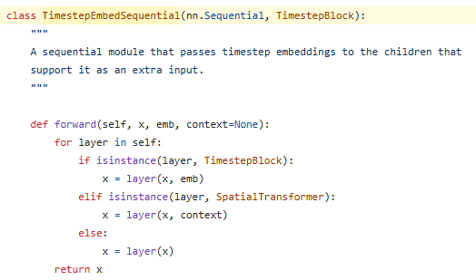
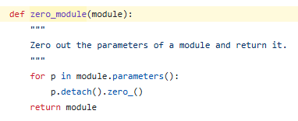
ControlNet
Zero-Convolution
“The "zero convolution" is 1×1 convolution with both weight and bias initialized as zeros.”
Code

Slide 11
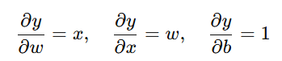
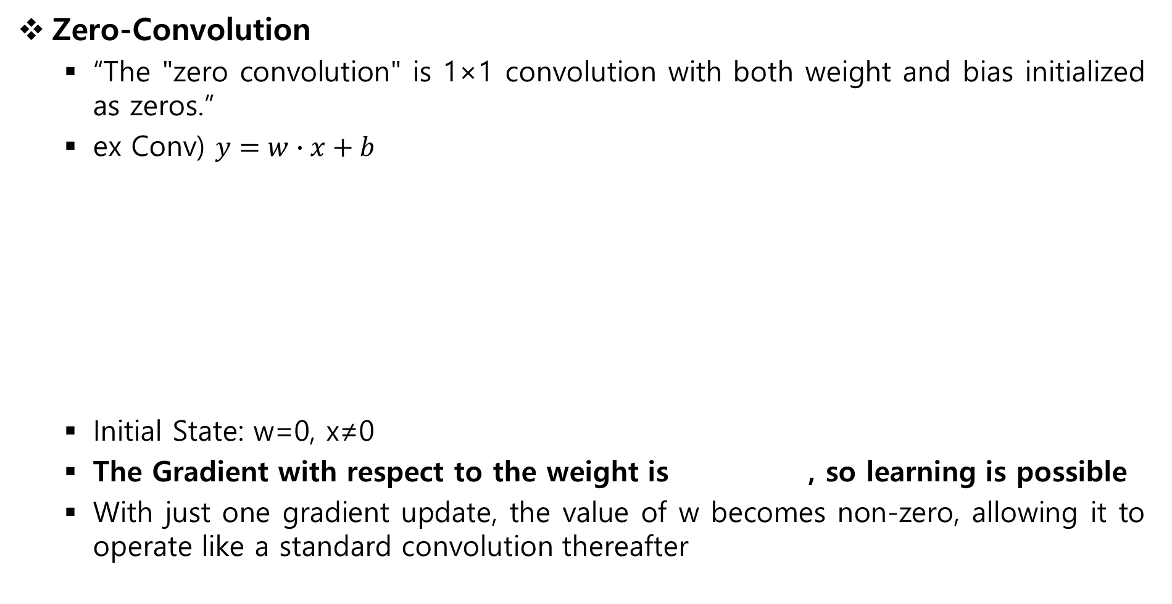
ControlNet
Zero-Convolution
“The "zero convolution" is 1×1 convolution with both weight and bias initialized as zeros.”
ex Conv) $y=w∙x+b$
Initial State: w=0, x≠0
The Gradient with respect to the weight is , so learning is possible
With just one gradient update, the value of w becomes non-zero, allowing it to operate like a standard convolution thereafter
partial derivative

